Slide 1

Social Media Impact – Suicidal Rates
UT Austin Data Analytics & Visualization Bootcamp – Final Project by :
Quang Nguyen
Tina Bellon
Ima Richburg
Nensi Dobaria
Namrata Shah

Slide 2
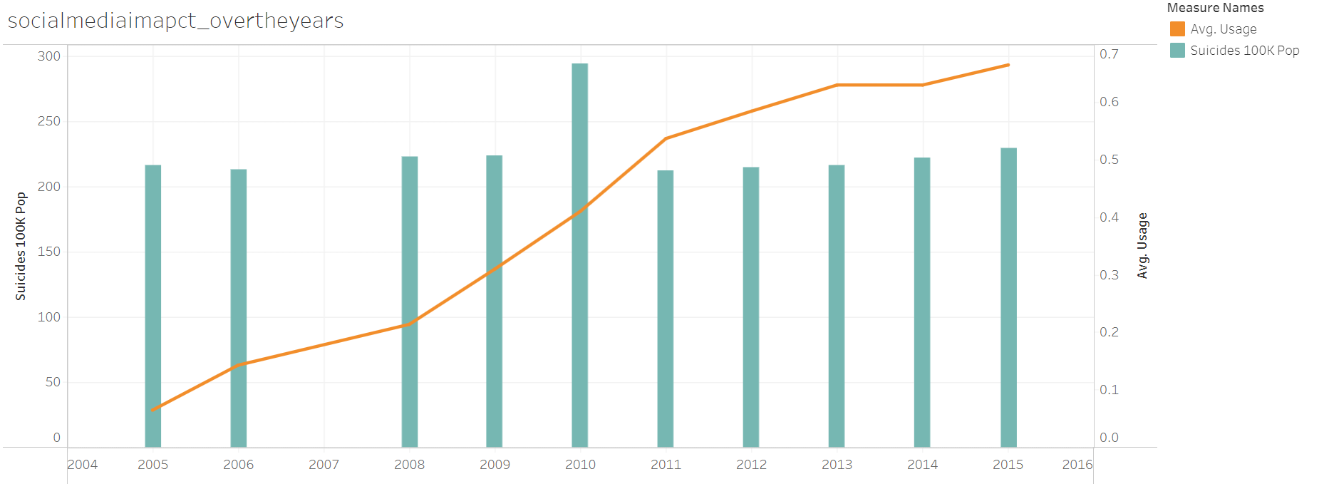
Reason for Topic Selection
Suicide is a serious societal problem and the result of complex socioeconomic and cultural factors. Even if our analysis should show that social media use only has a minimal impact, we believe any measure to decrease risk and increase suicide prevention is worth pursuing.

Slide 3
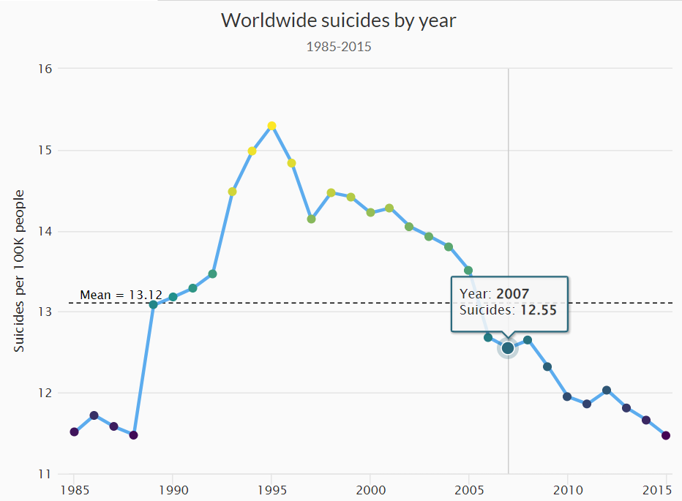
Suicide Rates Overview 1985 to 2016 – From Kaggle
We are using a suicide data set from Kaggle, which lists suicides from around the world by country from 1985 until 2015. The data is split by gender, age and generation, and also lists the respective country's Human Development Index and GDP in a particular year.

Slide 4
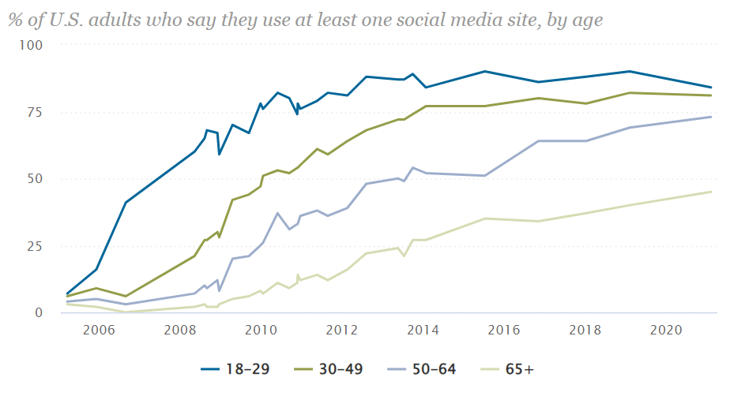
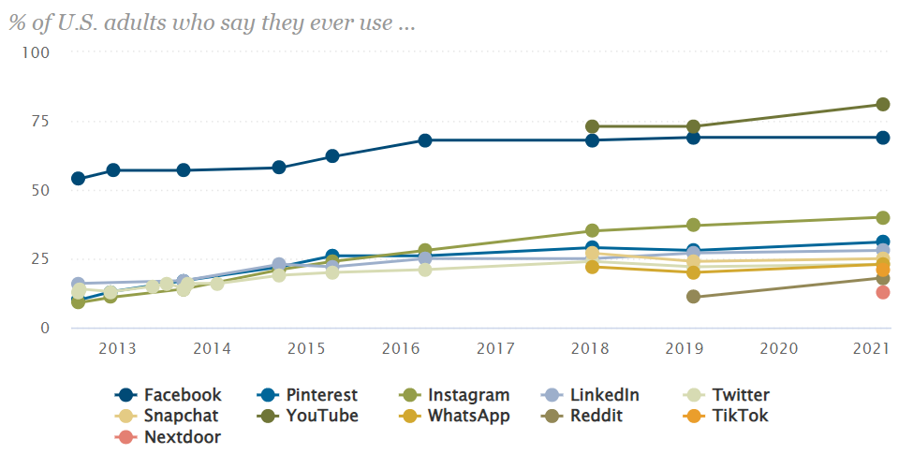
Social Media Fact Sheet – from Pew Research center
For social media usage, we rely on a Pew Research dataset that collected the share of U.S. adults using different forms of social media from 2005 through 2021. The data is broken down by age groups.

Slide 5
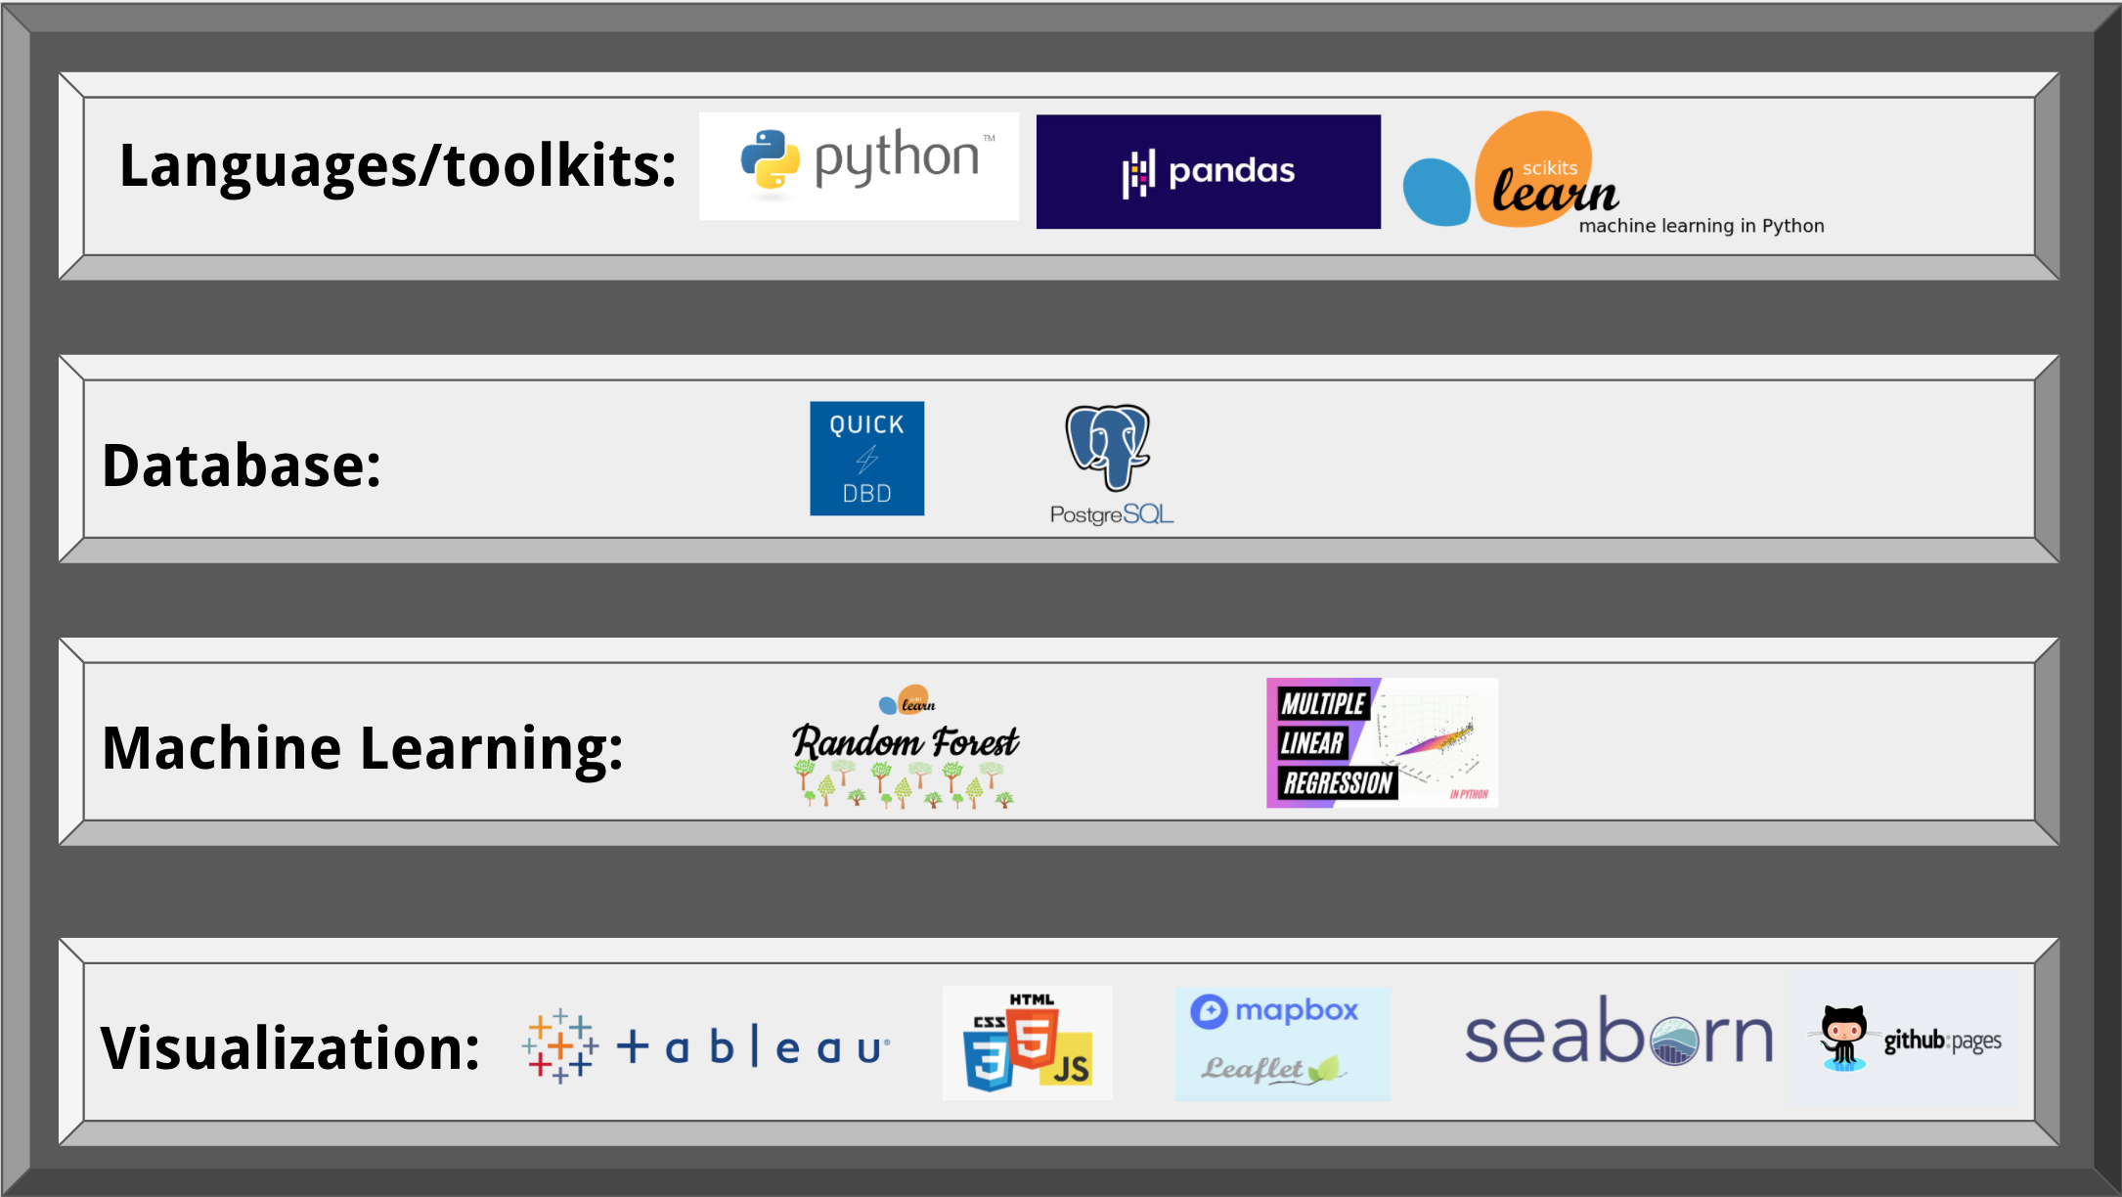
Applied Technologies

Slide 6
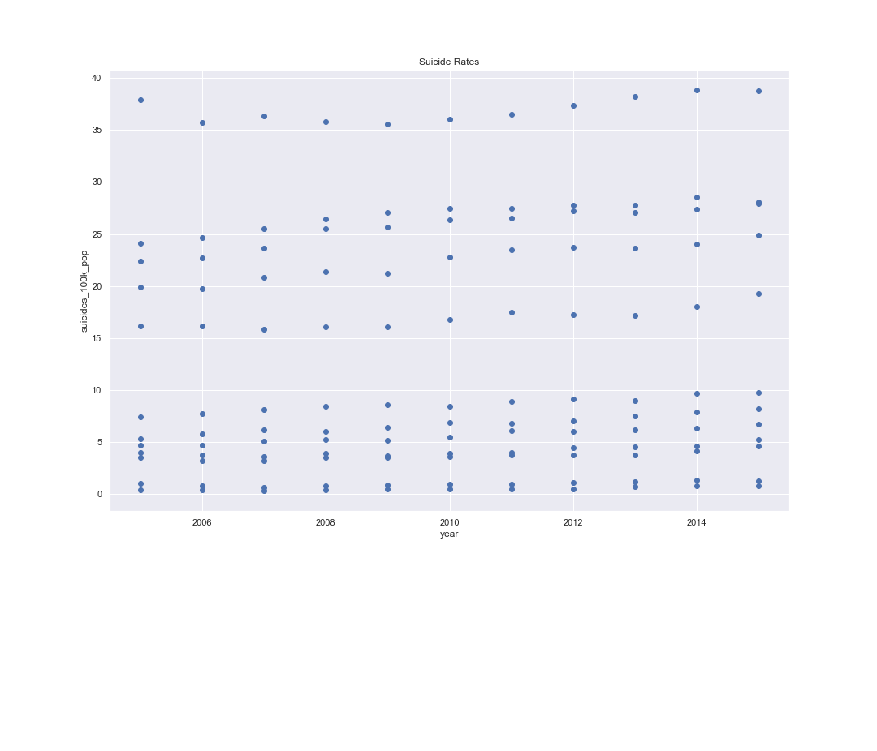
Machine learning – linear regression model
We plotted “year” versus “suicides_100k_pop” on a scatter plot to determine any trend. Based on the scatter plot, we saw a linear trend, which is best suited for machine learning regression models.

Slide 7
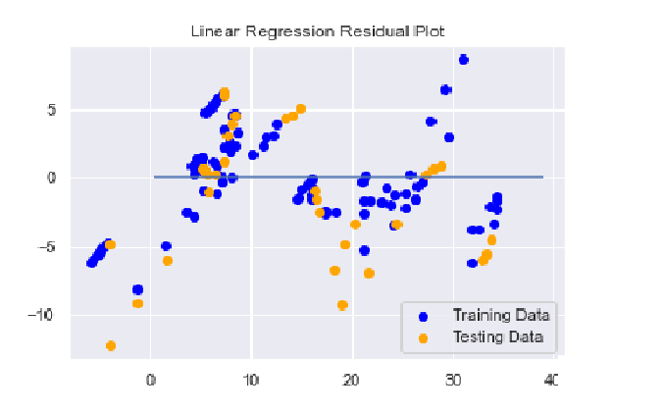
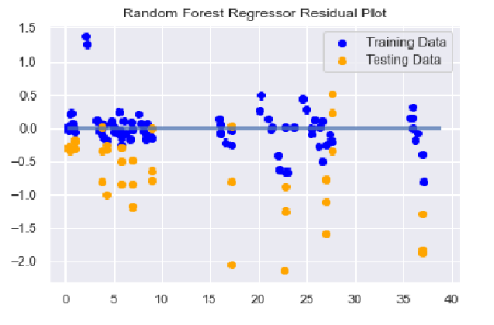
Machine learning – random forest regressor model
The random forest regressor model also showed improvement in the residual plot. A residual plot shows the difference between the true value of y and the predicted values of y, ideally, we want our predictions to be close to zero on the y-axis. We can see in the linear regression residual plot; the difference is between the ranges of negative 15 to 10. In the random forest regressor residual plot, the ranges improve by decreasing to a range of negative 2 to 1.5.

